Slide 3



Slide 4




Slide 7


Slide 8


Slide 9


Slide 15

Search
Watch Live
Home
UK
World
US
Business
Politics
Technology
Entertainment
Strange News
Weather
More

Slide 16

Timeline
Top Stories
i
LIVE

Slide 23
LIVE
Top Stories
UK News
World News

Slide 24

Video Title
Video Title
Video Title

Slide 25

Top Stories
Top Story: Headline
BREAKING NEWS
BREAKING NEWS
BREAKING NEWS
BREAKING NEWS
BREAKING NEWS
BREAKING NEWS
BREAKING NEWS
BREAKING NEWS
BREAKING NEWS
Description of the Top Story Headline.

Slide 26


Slide 28
0
0
:
0
0
BREAKING NEWS
BREAKING NEWS STORY
BREAKING NEWS
BREAKING NEWS STORY
BREAKING NEWS
BREAKING NEWS STORY
BREAKING NEWS
BREAKING NEWS STORY

Slide 29
Kay Burley

Slide 30
BREAKING NEWS

Slide 31
BREAKING HEADLINE

Slide 32
HEADLINE ONE

Slide 33
HEADLINE TWO

Slide 34
HEADLINE THREE

Slide 35
HEADLINE FOUR

Slide 36
HEADLINE FIVE

Slide 37
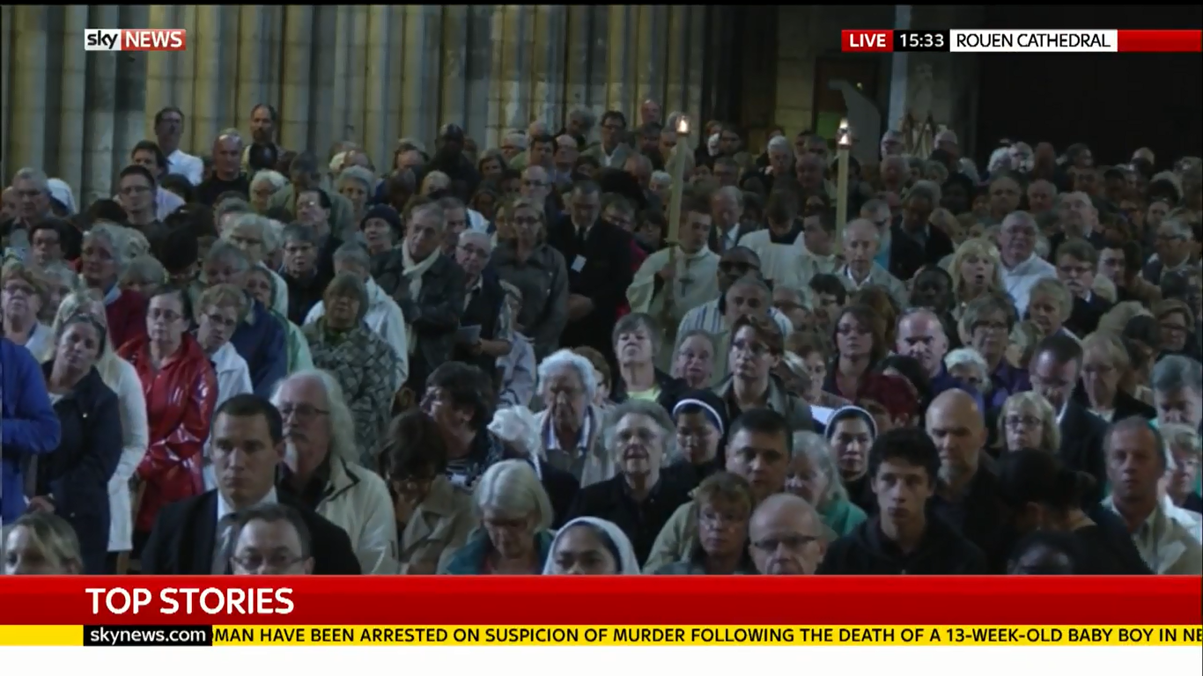

Slide 38
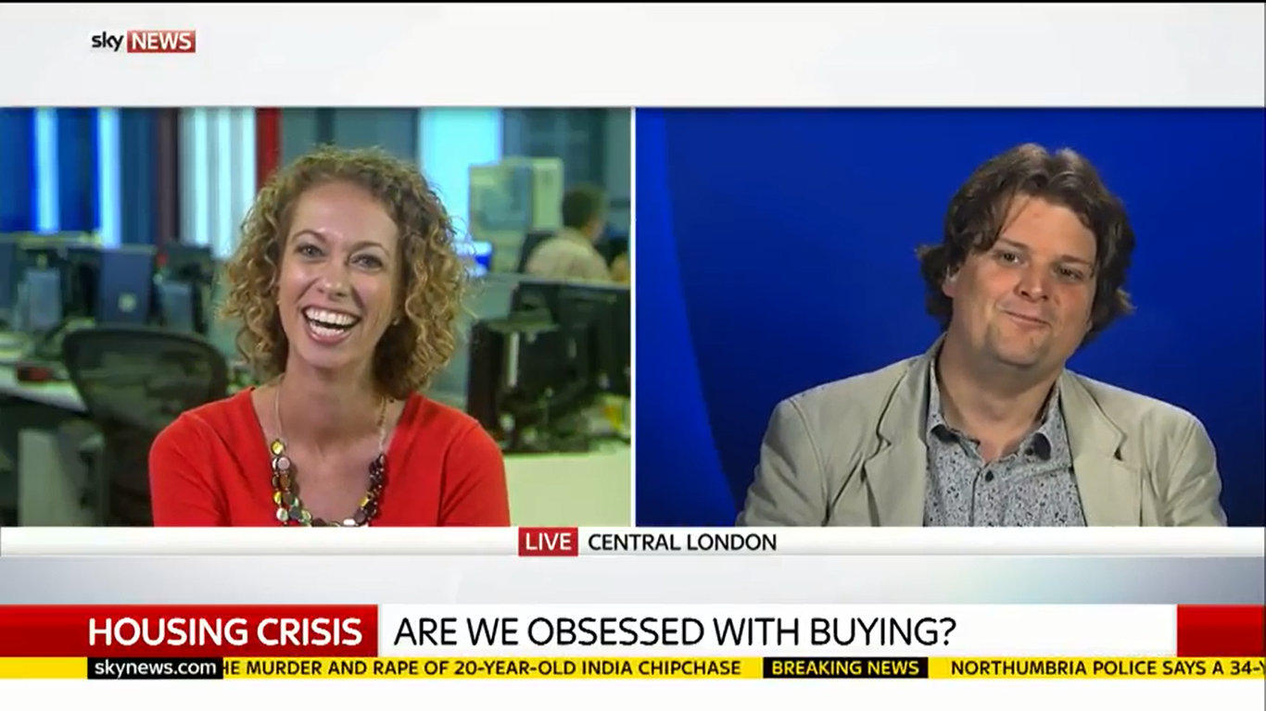

Slide 39
LIVE
LOCATION NAME

Slide 40
LIVE
1
0
:
0
0
LOCATION NAME

Slide 41
PICTURES
IMAGE/VIDEO SOURCE

Slide 42
REPLAY

Slide 43
EXCLUSIVE

Slide 44
PICTURES
IMAGE/VIDEO SOURCE

Slide 45
HEADLINE
PROFESSION
NAME

Slide 46
SKY NEWS CENTRE
LIVE
LOCATION NAME
IMMUNNISATION
COVERS

Slide 47
LOCATION NAME
LIVE

Slide 48
MORE ON

Slide 49



Slide 50
Eamonn Holmes

Slide 51
U.S. ELECTION
PROFESSION
NAME

Slide 52
HEADLINE

Slide 53
PROFESSION
INFORMATION ABOUT THE
BIG TEXT MAY BE DISPLAYED
BIG TEXT MAY BE DISPLAYED
NAME
HEADLINE GOES HERE

Slide 54
#skydebate
PROFESSION
TOPIC OF DEBATE
TOPIC OF DEBATE
NAME

Slide 55
PROFESSION
NAME

Slide 56
BREAKING NEWS

Slide 57
INFORMATION ABOUT THE
SKY CORRESPONDANT
BREAKING HEADLINE
INFORMATION ABOUT THE
BREAKING HEADLINE GOES HERE
CORRESPONDANT
BREAKING HEADLINE GOES HERE

Slide 58
PROFESSION
NAME

Slide 59
BREAKING NEWS
PROFESSION
NAME

Slide 60
BREAKING NEWS
BREAKING HEADLINE
PROFESSION
NAME

Slide 61
Press Preview

Slide 62
PROFESSION, NEWSPAPER
PROFESSION, NEWSPAPER
#SkyPapers
#SkyPapers
news@sky.com
news@sky.com
84501
84501
Costs 25p plus
Costs 25p plus
NAME
NAME
network charges
network charges

Slide 63
DECISION TIME

Slide 64
DECISION TIME

Slide 65
DECISION TIME

Slide 66
10pm EXIT POLL RELEASED
EXIT POLL COUNTDOWN
5
3
1
2
4
6
9
8
0
7
0
0
:
0
0
0
:
1

Slide 67
CON
LAB
LD
UKIP
SNP
OTH
EXIT POLL
316
239
10
2
58
25
CONSERVATIVES LARGEST PARTY

Slide 68
EXIT POLL
AWAITING RESULTS …
TARGET
326 TO WIN
CONSERVATIVES LARGEST PARTY
AWAITING RESULTS …
0
0
0
0
0
0
AWAITING RESULTS …

Slide 69
LAB HOLD HOUGHTON & SUNDERLAND S
AWAITING RESULTS …
TARGET
326 TO WIN
AWAITING RESULTS …
0
0
0
0
0
0
AWAITING RESULTS …
1

Slide 70
Kay Burley

Slide 71
Eamonn Holmes

Slide 73

HOUGHTON & SUNDERLAND SOUTH

Slide 74
Richard Elvin
UKIP
8,280
…
Stewart Hay
CON
7,105
…
Jim Murray
LIB DEM
719
…
Bridget Phillipson
LAB
21,218
…
Alan Robinson
GREEN
1,095
…

Slide 75
RESULT

Slide 76
COMING UP

Slide 77
HEADLINE

Slide 78
ON MOBILE NOW

Slide 79
HEADLINE

Slide 80
WASHINGTON

